Slide 1


Recapture Photo Detection
Detecting Re-shot Images Using Deep Learning
A comprehensive deep learning approach to identify whether images are original or recaptured from screens and paper surfaces.
BY : UZER AHMED (M.Sc. Data Science)
Supervisor : Prof. George Azzopardi (Associate Professor)

Slide 2
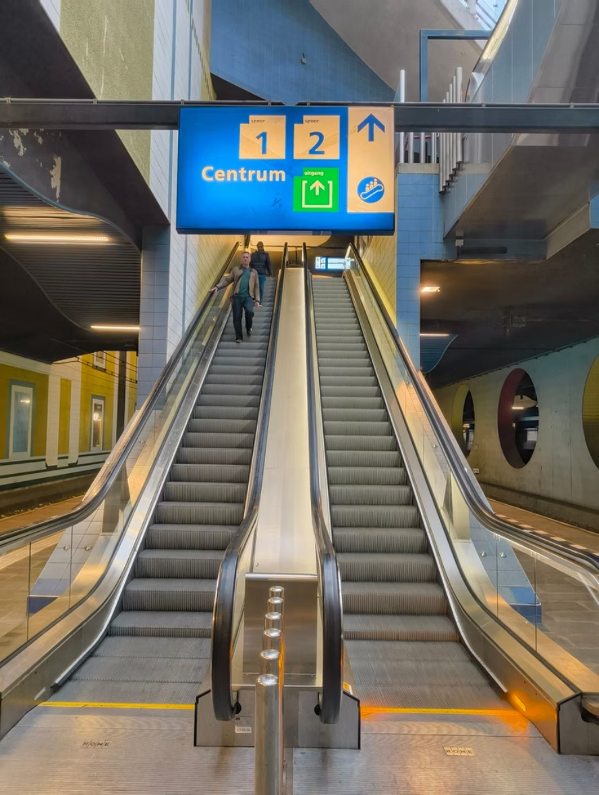
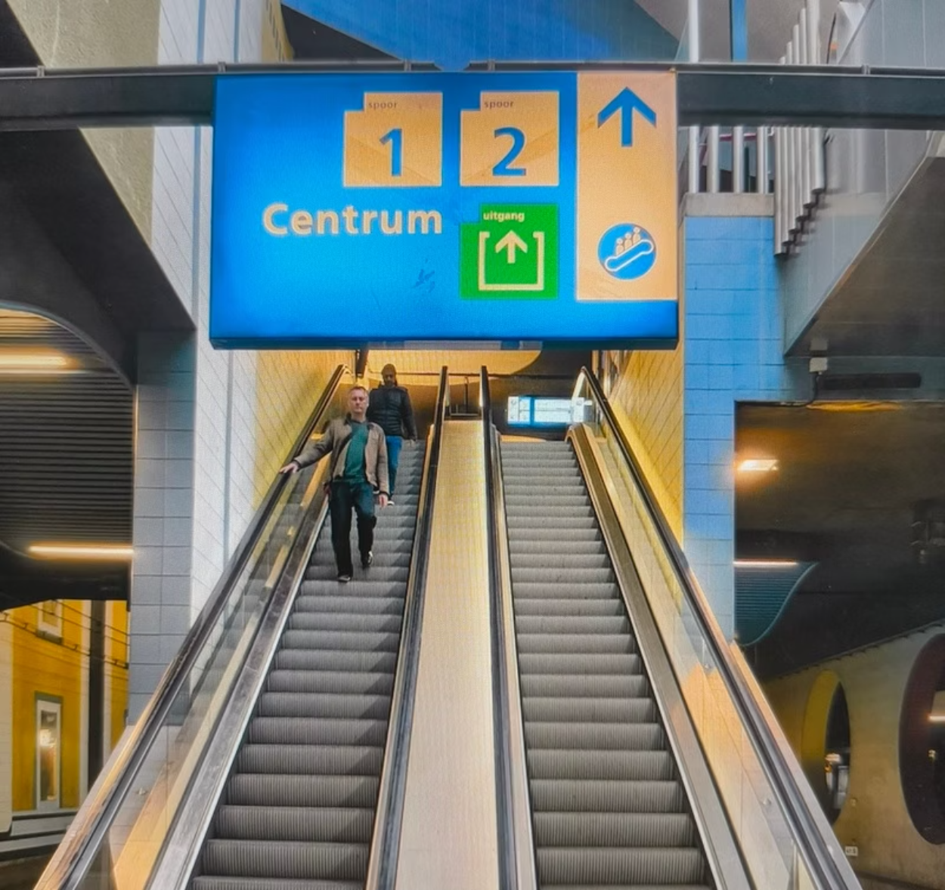
What is Recapture Detection?
Recapture detection identifies whether an image is original or re-shot from a screen or paper source. When images are photographed from displays, they acquire distinctive distortions including moire patterns, motion blur, color artifacts, and aliasing effects. This technique is fundamental to computer vision applications requiring image authenticity verification.
Original Image
Recaptured Image

Slide 3








Why Recapture Detection Matters
Data Security
Fraud Prevention
Prevents unauthorized screen captures of sensitive information, reducing data breach risks in secure environments.
Detects forged identification documents and spoofed credentials by identifying recaptured versions of authentic originals.
Integrity Assurance
Enterprise Protection
Ensures media authenticity in applications requiring provenance verification and digital forensics.
Enables banks, government agencies, and corporations to verify document authenticity during KYC processes and compliance checks.

Slide 4

Research Foundation & Datasets
Primary Datasets
Academic References
Roselab Dataset – Nanyang Technological University, Singapore. Comprehensive collection of original and recaptured images across multiple capture conditions.
IEEE 2023 – Advanced recapture detection methodologies using neural networks.
CVPR 2022 – Screen-recapture artifact detection using computer vision techniques.
Custom Collected Dataset – Carefully curated and labeled originals versus recaptured images, including mobile device captures.
ICCV 2022 – Domain generalization approaches for robust detection across devices.

Slide 5
Core Technical Concepts
Moire Patterns
Chromaticity Map
Vision Transformer
Wavy interference patterns created when screen pixels interact with camera sensors during recapture.
Color-space analysis highlighting aberrations and color shifts unique to recaptured images.
State-of-the-art deep learning architecture based on self-attention mechanisms for image classification.
Adapter Networks
Domain Generalization
Triplet Loss
Lightweight, parameter-efficient modules that extend pre-trained models without full retraining.
Training methodology ensuring model robustness across diverse devices, lighting, and capture conditions.
Learning objective that groups similar images while maximizing distance between different classes.

Slide 6
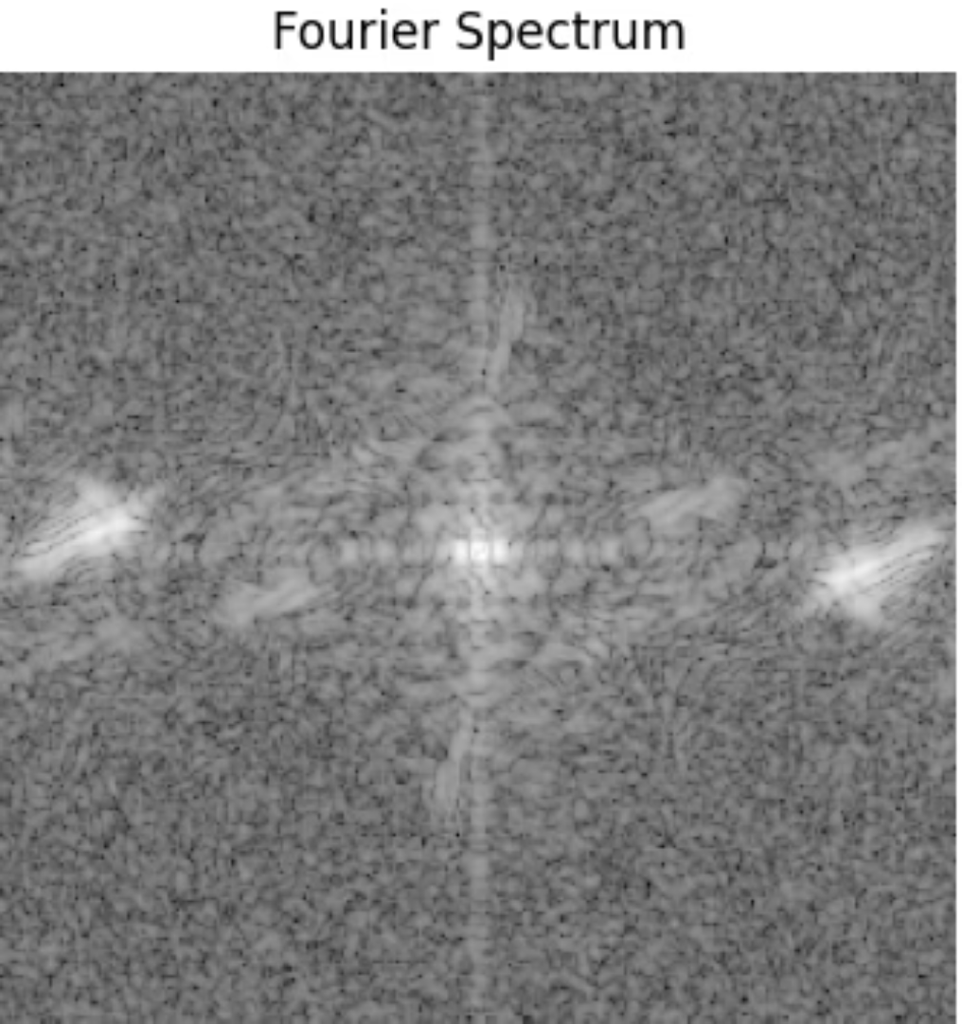
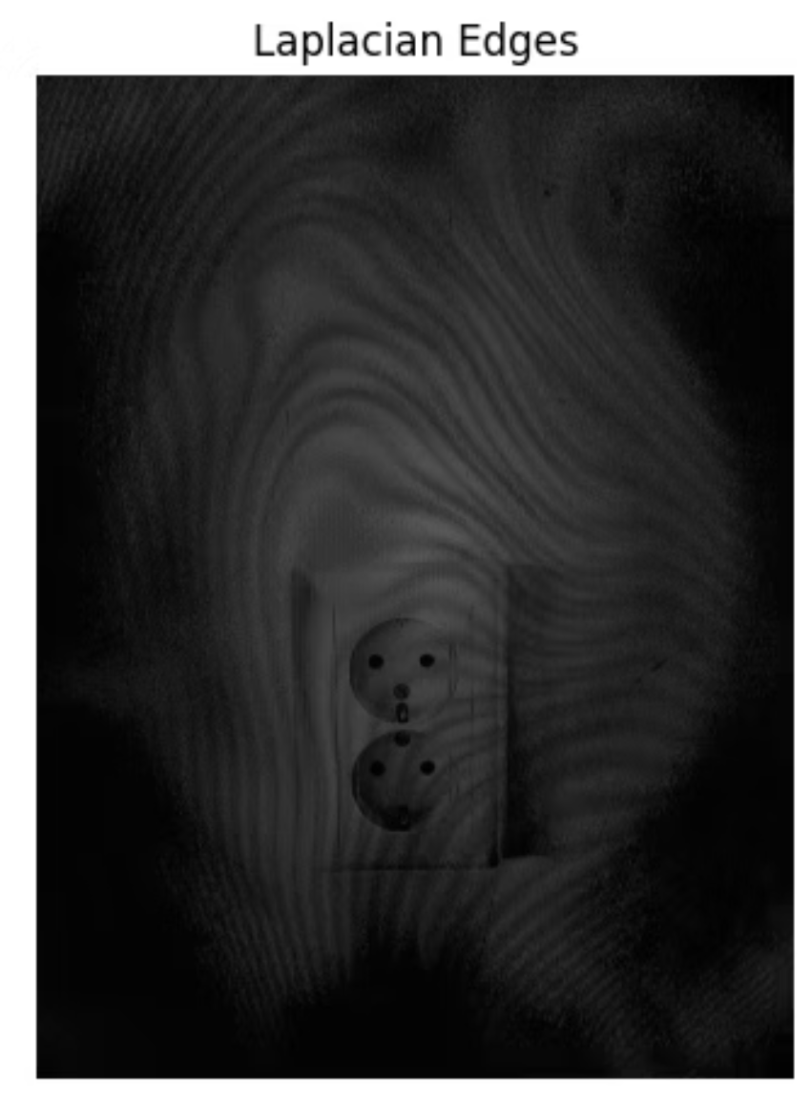
Image Processing Methods
Two complementary approaches reveal recapture artifacts through different analytical lenses:
Fourier Transformation
Laplacian Filter
Converts img to frequency domain, exposing periodic moire patterns and repetitive distortions characteristic of screen recaptures. Enables detection of subtle artifacts invisible in spatial domain.
Edge detection operator capturing fine details and sharpness degradation. Highlights loss of clarity and definition typical of recaptured images, revealing noise and blur characteristics.

Slide 7
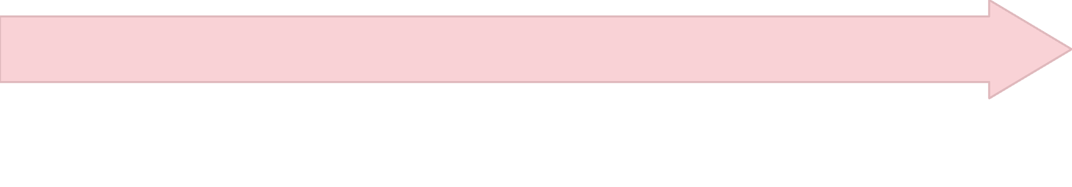

Experimental Pipeline
STEP : 1
STEP : 2
Preprocessing
Data Collection
Apply Fourier and Laplacian transformations. Normalize to 224×224 resolution for model input.
Aggregate originals and recaptured images from Roselab and custom datasets.
STEP : 3
STEP : 4
Model Training
Evaluation
Train multiple architectures with batch size 16, learning rate 1e-4, using Adam optimizer over 8 epochs.
Assess accuracy, precision, recall, and F1-score on held-out test set. Analyze confusion matrices.
Configuration: IMG_SIZE=224, BATCH_SIZE=16, EPOCHS=8, LEARNING_RATE=1e-4, OPTIMIZER=Adam

Slide 8
Models Tested & Architecture Comparison
Seven distinct architectures evaluated, combining various preprocessing techniques with baseline and advanced networks:
Model Architecture
Preprocessing
Parameters
Simple CNN
RGB
0.8M
Fourier-CNN
FFT
0.9M
Fourier-MobileNetV2
FFT
3.5M
Laplacian-MobileNetV2
Laplacian
3.5M
Dual-Transform-MobileNetV2
FFT + Laplacian
7.0M
RGB-MobileNetV2
RGB
3.5M
RGB-EfficientNetB0
RGB
5.3M
EfficientNetB0 emerged as optimal, balancing computational efficiency with superior performance.

Slide 9
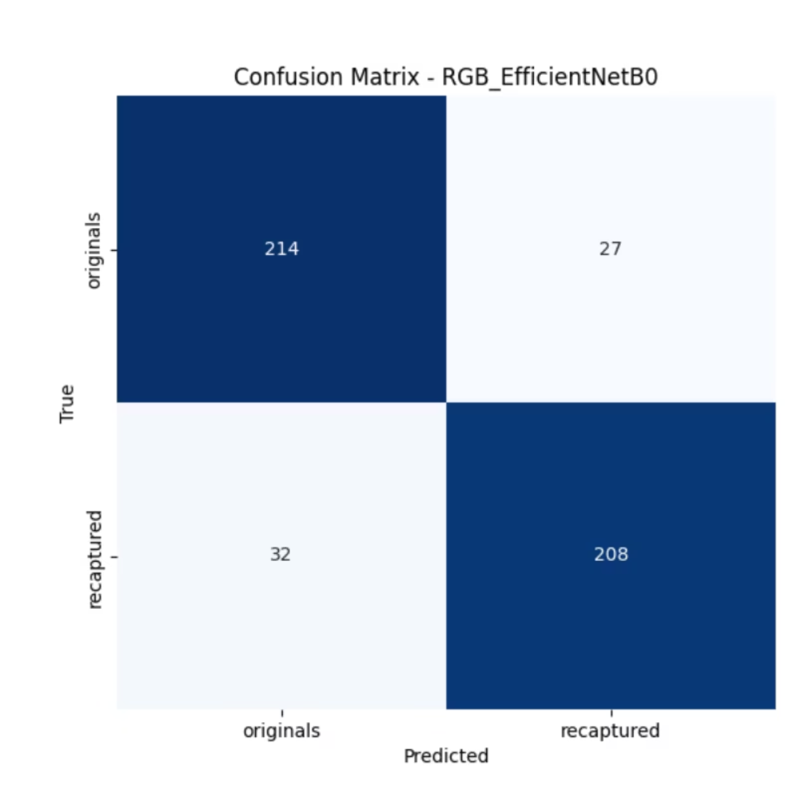
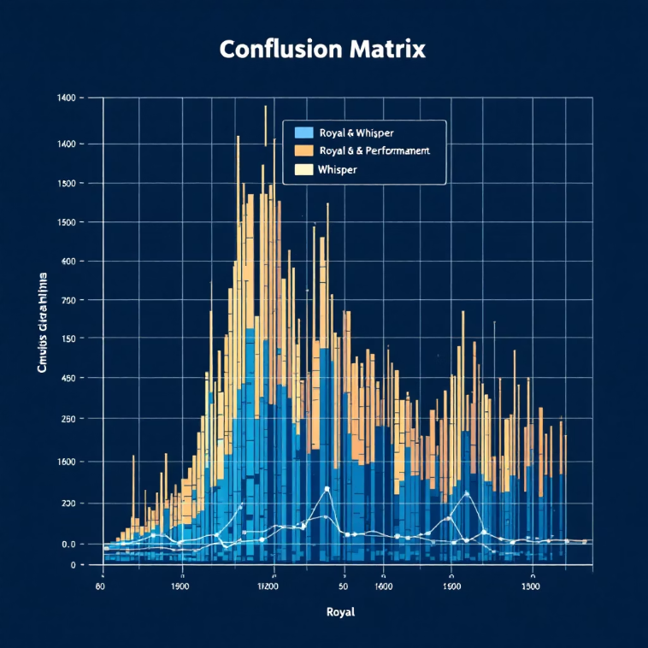
Performance Results & Evaluation
Comprehensive evaluation across multiple performance metrics reveals RGB-EfficientNetB0 as the top performer with balanced and stable results:
0.86
0.86
0.86
0.85
Accuracy
F1-Score
Precision
Recall
RGB-EfficientNetB0 achieved 86% classification accuracy on test set.
Perfect balance between precision and recall across both classes.
86% of predicted recaptures were correctly identified, minimizing false positives.
Captures 85% of actual recaptured images, ensuring high detection sensitivity.
Comparative Analysis
Laplacian-MobileNetV2: 74% accuracy, specialized in edge artifacts but limited generalization.
RGB-MobileNetV2: 73% accuracy with high recall (90%) but lower precision.
RGB-EfficientNetB0 (Winner): Achieves best overall balance with std=0.02 across folds, demonstrating exceptional stability.

Slide 10




Key Insights & Future Directions
Validated Insights: Frequency and edge-based preprocessing significantly enhance recapture detection. Simple RGB input with efficient architectures outperforms specialized preprocessing approaches when combined with modern deep learning techniques.
Vision Transformers + Adapters
Domain Generalization
Expanded Dataset Coverage
Integrate self-attention mechanisms and parameter-efficient adapters for enhanced generalization across device types.
Develop robust models that maintain performance across diverse cameras, resolutions, and environmental conditions.
Incorporate real-world mobile screen recaptures, varying lighting conditions, and emerging device technologies.
Towards Reliable Recapture Detection for Secure Vision Systems

Slide 11


Q&A and Next Steps
Questions & Discussion
Next Steps
📊 Integrate EfficientNetB0 baseline into Vision Transformer pipeline
Dataset & Model Optimization
🔬 Add Adapter-based fine-tuning for new recapture sources
We welcome questions on dataset preprocessing and model optimization.
🚀 Prepare for submission to IEEE Journal or conference poster
Deployment Considerations
Open for discussion on technical implementation and real-world applications.
Thank you — Open for discussion and collaboration.

